Slide 1
Group Project: Smart Contracts Tuition Fee
Cedric Schröter, Philip Steiger und Jonas Löffler 10.12.18

Slide 2
Background & Idea 1/2
Main essence of smart contracts: Transaction consensus
Disrupt the fixed tuition based university systems
Free entry, no tuition payable up front
Tuition payment is based on in-class performance of professors
Incentive based payment system
50% goes to professor
40% university
10% best professor
We ignore any game theoretical implications
Problem: Universities may give false information about incoming fees
Solution: Smart contracts and consensus

Slide 3
Background & Idea 2/2
Students pay tuition through smart contract
Accessible for professors and students
Code is law
Course List
addclass('0x545c2Fbd2eca50dD9510482B57aB05FB709232a5 ', "Bitcoin, Blockchain and Kryptoassets – Fabian Schär");
addclass('0xd0c5d178a1b4174799eE0E17129B0dE413394903 ', "Blockchain, Consensus Protocols and Smart Contracts – Alexander Berentsen");
The Code

Slide 4
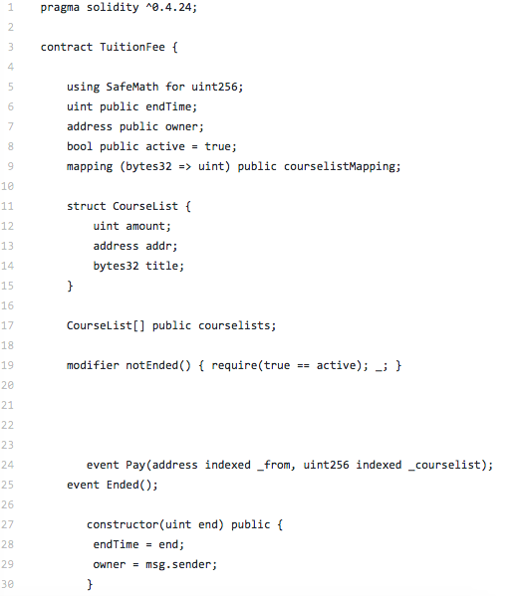
Code 1/3
Declare state variables
Define modifiers
Define events

Slide 5
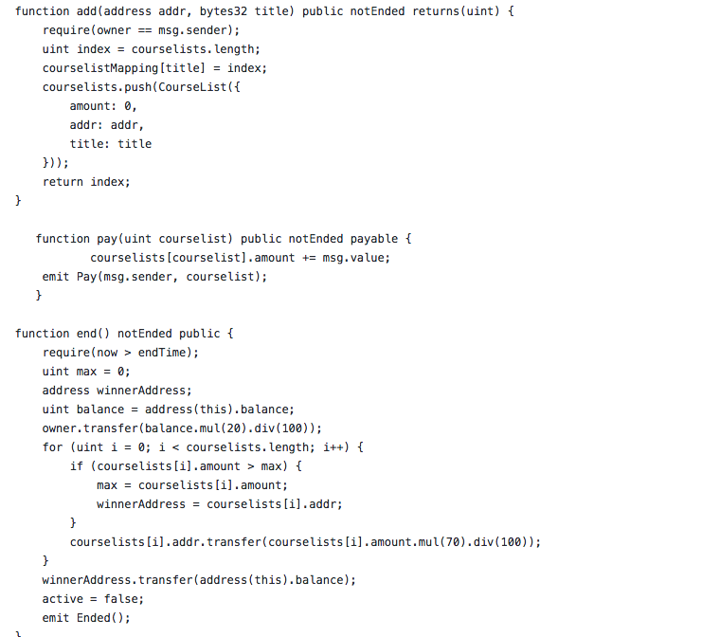
Code 2/3
Add Address
Pay
End

Slide 6
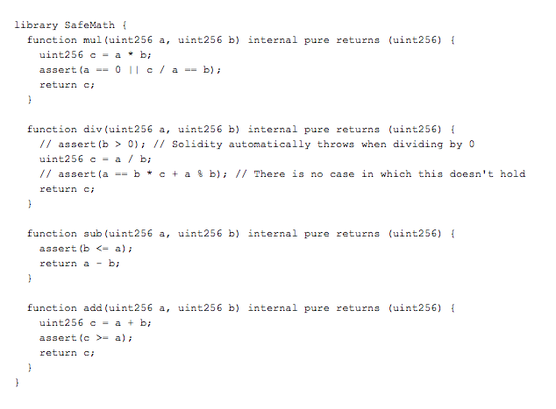
Code 3/3
Implement a library

Slide 7
Deployment and Interaction
Source: https://github.com/trapp/smart-contract-intro (Trapp, 08.12.2018)

Slide 8
Conclusion ”Economists are best in finding specialists to get the job done.” (Berentsen, 2018)

Slide 9
Thank you for your attention.

